Slide 1
D-Ware Project
Frontend project with API integration

Slide 2
Project Overview & Features
Web –Based internal tool for managing flat files connections.
Compare and manages data across various sources.
Can Add ,Delete, Edit and Run the data which will help to compare the similarities and identify recurring values easily.
Features like adding new connections (SQL ,SnowFlake , Salesforce , etc).
Flat file upload and download support (CSV, XLSX, JSON).

Slide 3
Technologies :
Frontend : React/Vite , Tailwind CSS And React-Router-DOM
API: Axios , REST API
File-Management: Excel , CSV ,Zipped Export And JSON

Slide 4
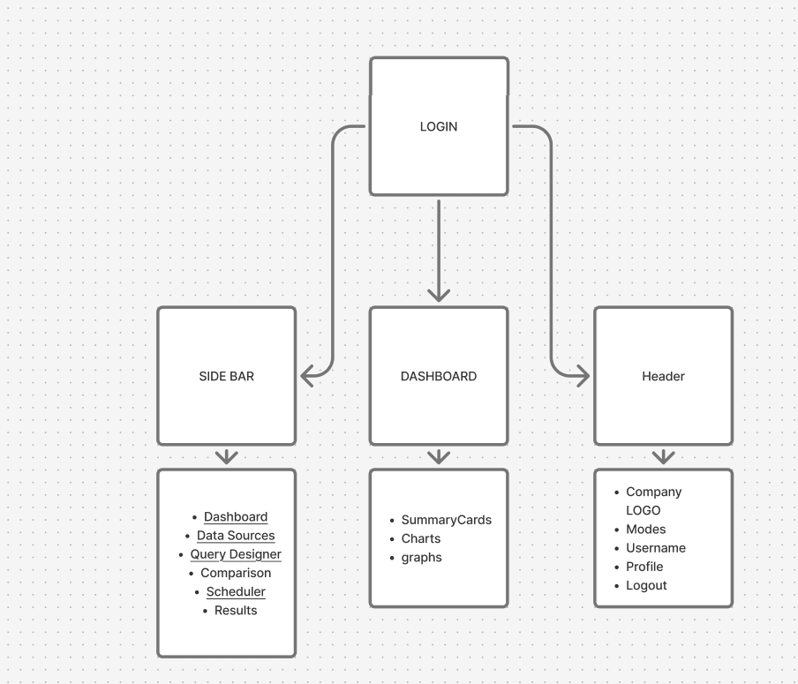
Architecture:

Slide 5

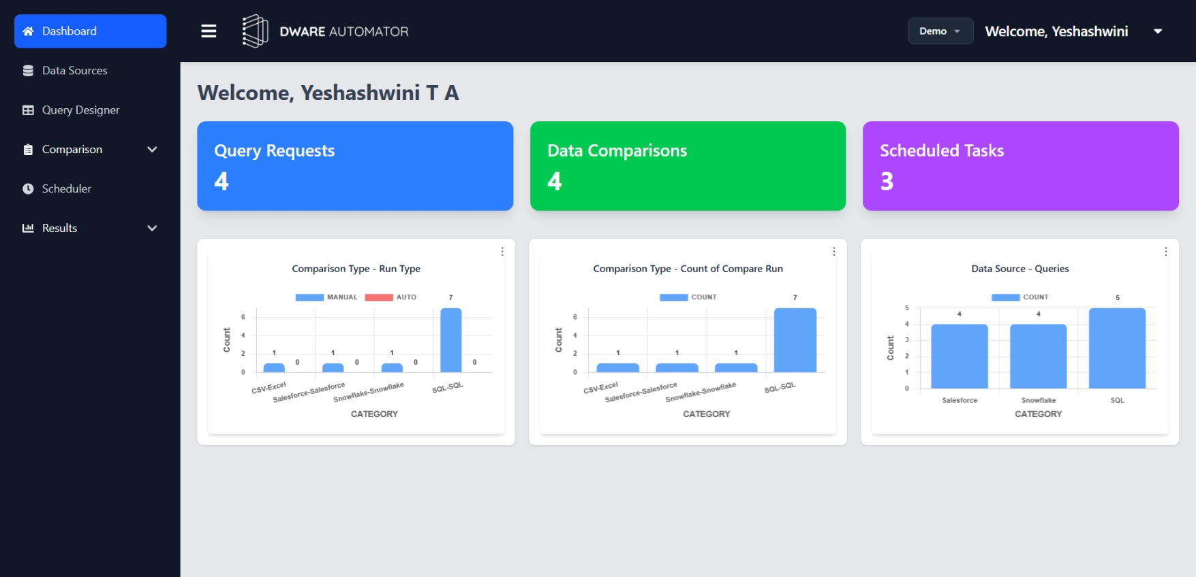
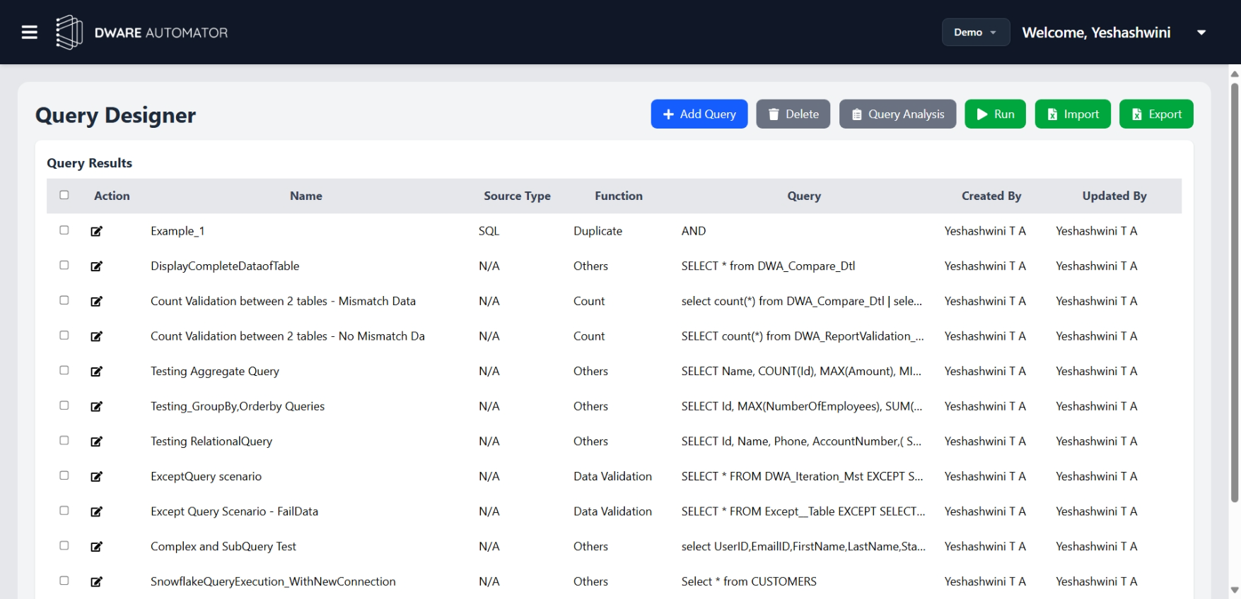
UI Samples:

